Slide 1
Learning Dynamic Segmentation and Compression
of Sequences in Transformer LLMs
Adrian Łańcucki
alancucki@nvidia.com
October 16th, 2025

Slide 2
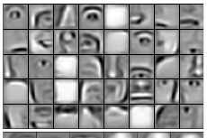
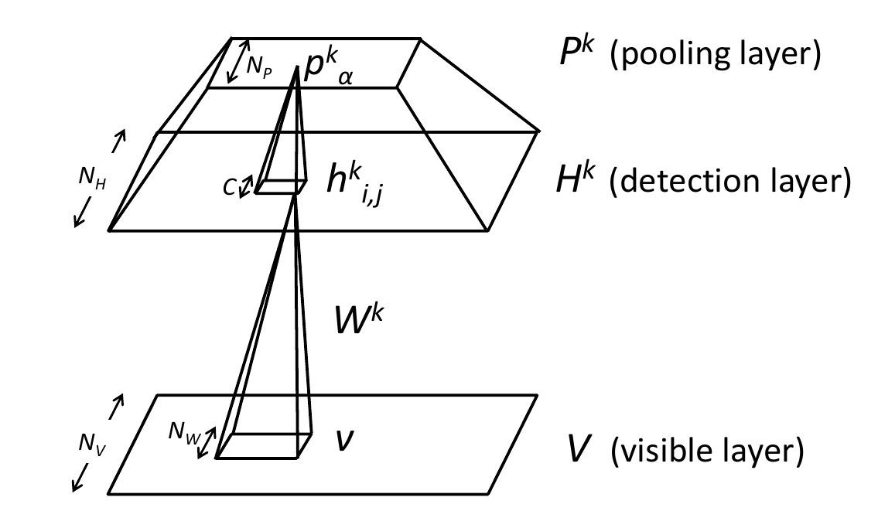

Motivation
CNNs naturally extract hierarchical features of images.
No proven end-to-end mechanism for autoregressive sequence models.
H. Lee, R. B. Grosse, R. Ranganath, and A. Y. Ng, “Convolutional deep belief networks for scalable unsupervised learning of hierarchical representations,” ICML 2009
Notes:
We lack a downsampling primitive for language/text
Convs make the hierarchies emerge
Got used to the fact that the resolution doesn’t change

Slide 3
Motivation
A fixed resolution is not optimal
Softmax
Linear
Generation of multiple tokens at a time
Normalization
Transformer block
Early exit
Transformer block
…
Sparse attention patterns
Transformer block
Transformer block
Early layers reassemble words
Embedding
chars → words → subwords → 128k+ subwords
Tokenizer
Notes:
We don’t have an automatic way of adjusting input resolution
We’re stuck with redundancies in sequences
I’ll show rather simple, practical algorithms

Slide 4
The Hourglass Transformer
Fixed-stride pooling
Great for images (original paper)
Also for speech (wav2vec2 DeepLearningExample)
https://github.com/NVIDIA/DeepLearningExamples/tree/master/PyTorch/SpeechRecognition/wav2vec2
P. Nawrot, S. Tworkowski, M. Tyrolski, L. Kaiser, Y. Wu, C. Szegedy, H. Michalewski, Hierarchical Transformers Are More Efficient Language Models, NAACL 2022

Slide 5
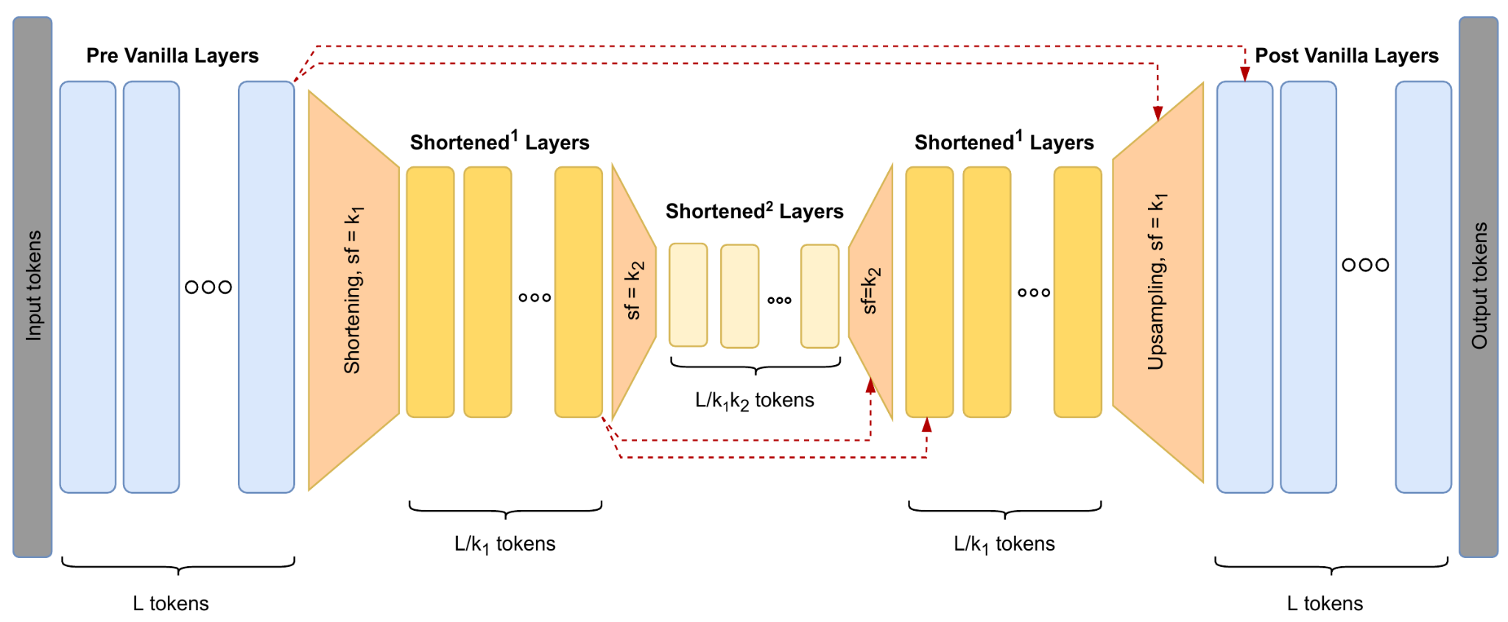
The Hourglass Transformer
P. Nawrot, S. Tworkowski, M. Tyrolski, L. Kaiser, Y. Wu, C. Szegedy, H. Michalewski, Hierarchical Transformers Are More Efficient Language Models, NAACL 2022

Slide 6
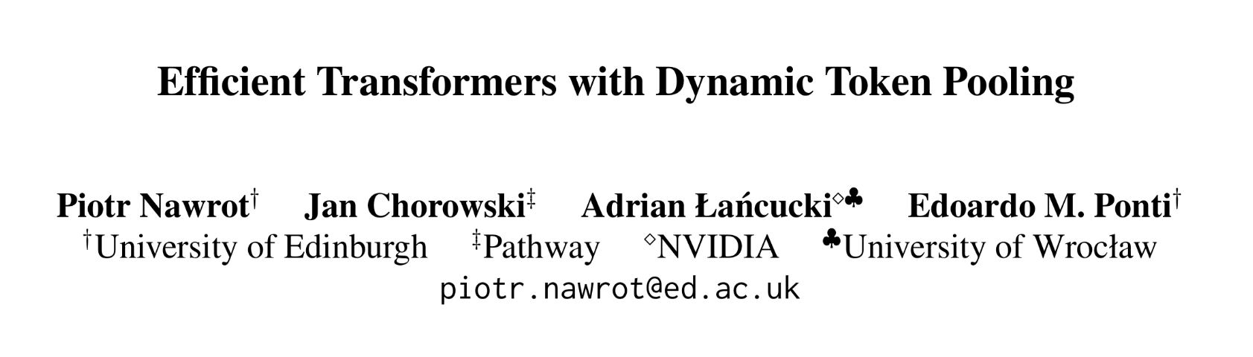

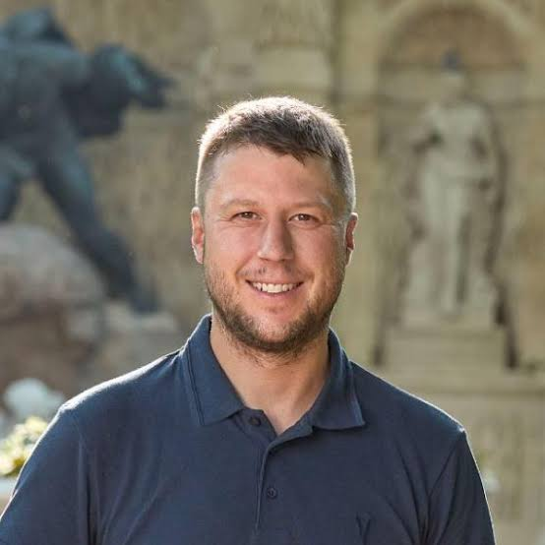

Dynamic-Pooling Transformer (ACL 2023)
Piotr Nawrot
Jan Chorowski
Edoardo M. Ponti
Character-level Hourglass for language modelling
Dynamically adapts pooling window size

Slide 7
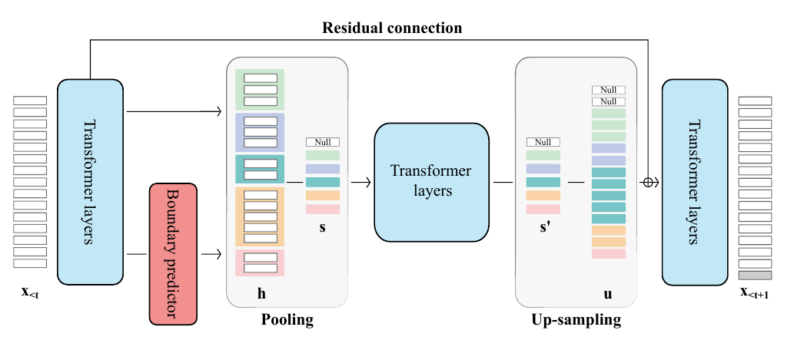
DPT Architecture

Slide 8
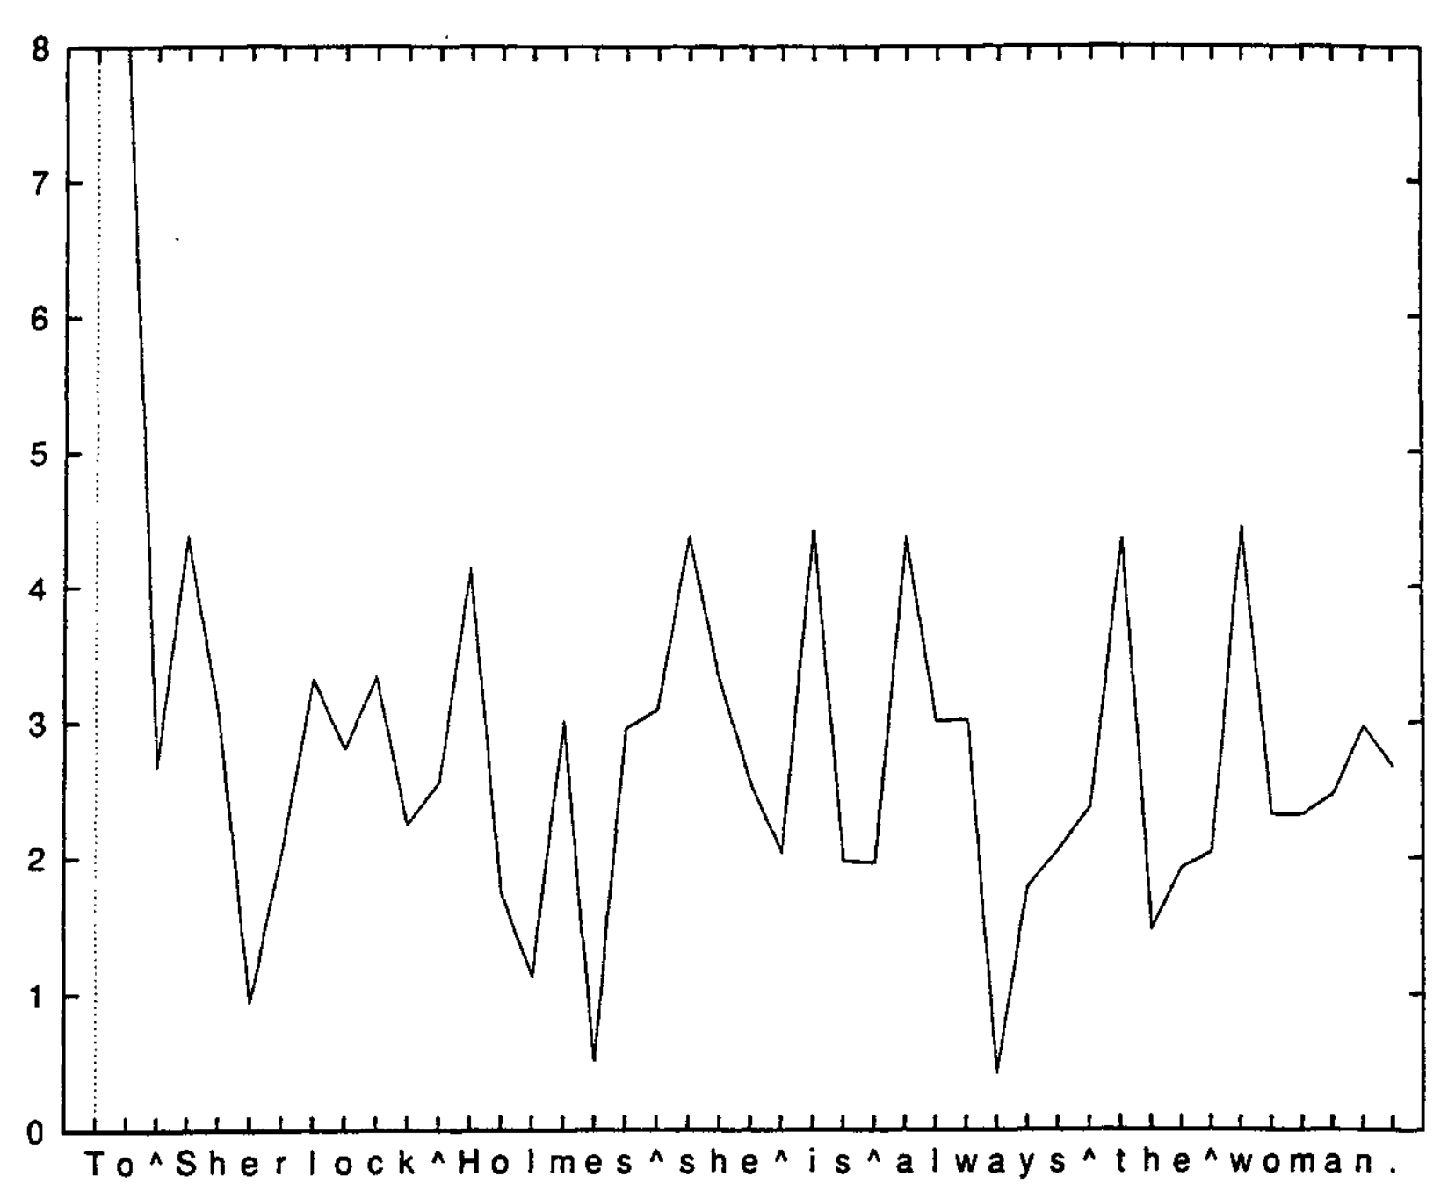
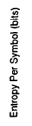
How to Train a Boundary Predictor?
Word boundaries are points of high uncertainty
Figure from: L. Hutchens, M.D. Alder, Finding Structure via Compression, CoNNL, 1998
Notes:
Token boundaries where spaces are is a clean mental framework

Slide 9
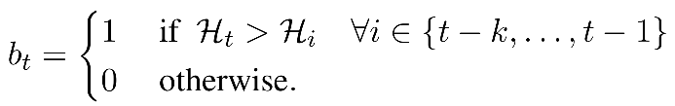
How to Train a Boundary Predictor?
Supervised (training data: tokenizer output or whitespace)
Unsupervised: Gumbel-Softmax for locating segment boundaries
Self-supervised: Heuristically detected entropy spikes
Uses conditional entropy estimated by the model itself

Slide 10
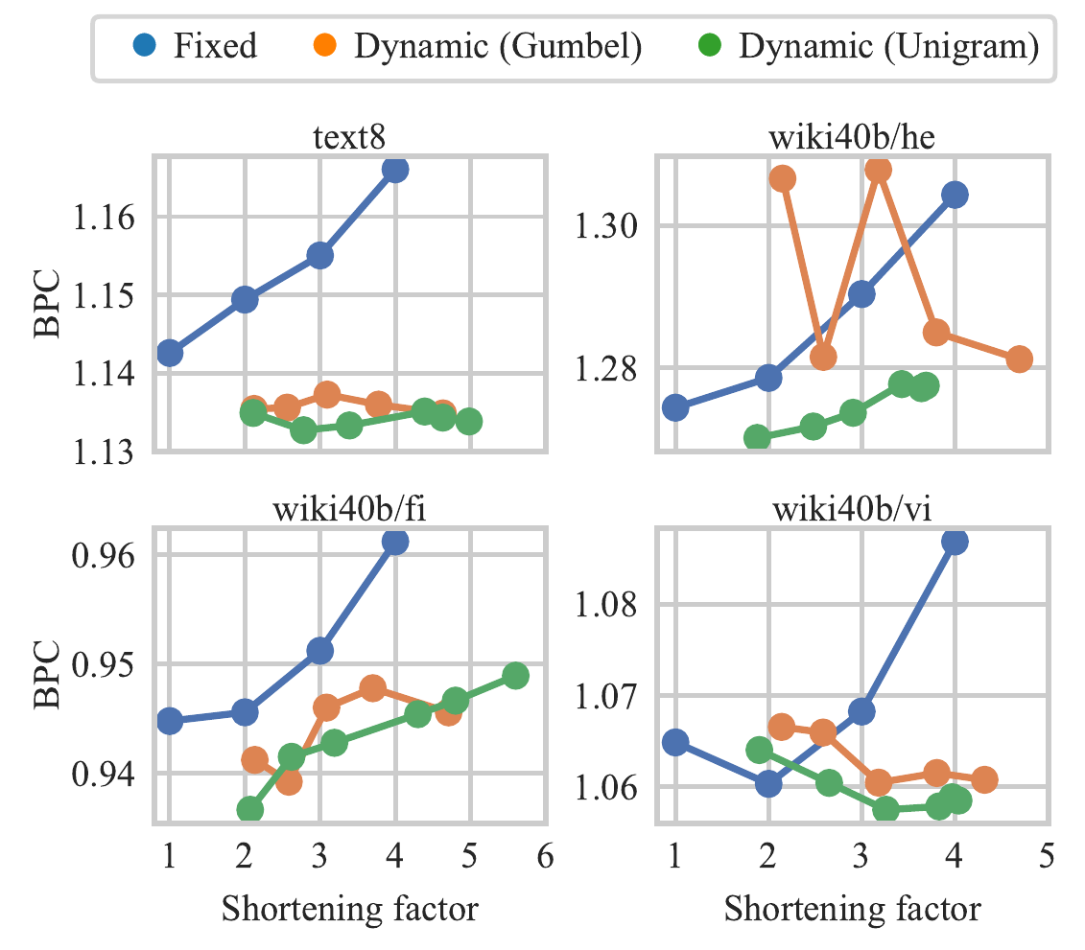
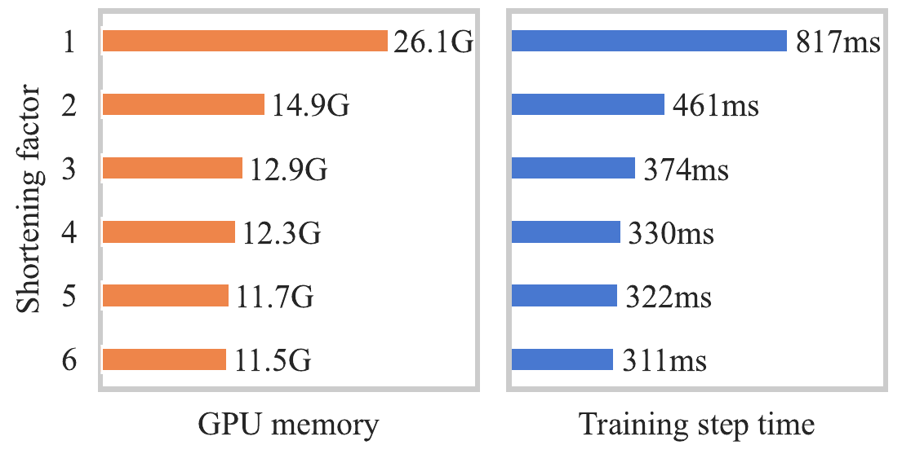
Results
English
Hebrew
Finnish
Vietnamese

Slide 11
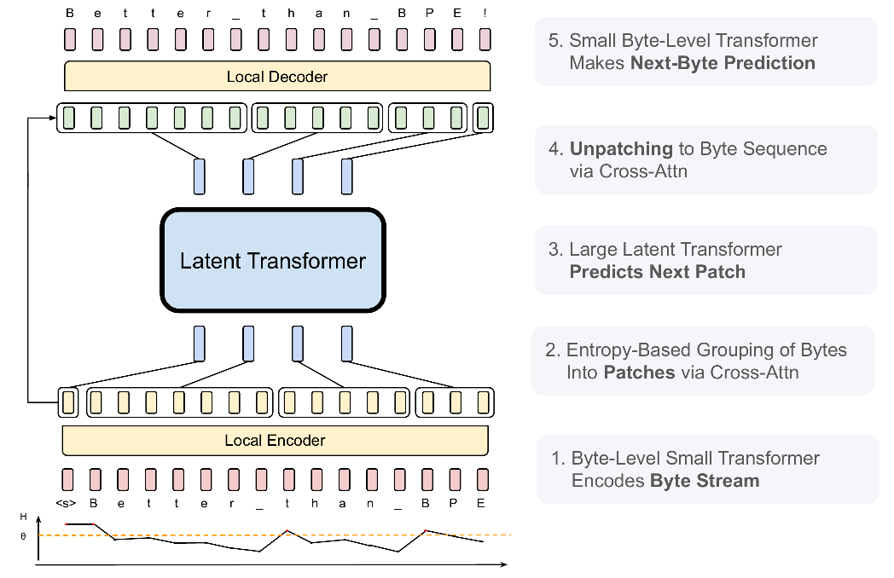
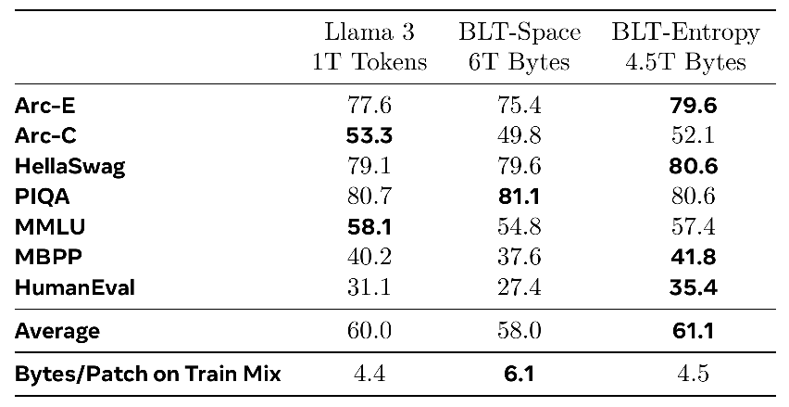
Byte-Latent Transformer
Dynamic Pooling Executed at Scale
Accuracy of 8B BLT models
Images from: A. Pagnoni, R. Pasunuru, P. Rodriguez, J. Nguyen, B. Muller, M. Li, C. Zhou, L. Yu, J. Weston, L. Zettlemoyer, G. Ghosh, M. Lewis, A. Holtzman, S. Iyer, Byte Latent Transformer: Patches Scale Better Than Tokens, 2024.
Notes:
Well-engineered at scale, separate model for entropy estimation
Entertaining character-level tasks section

Slide 12
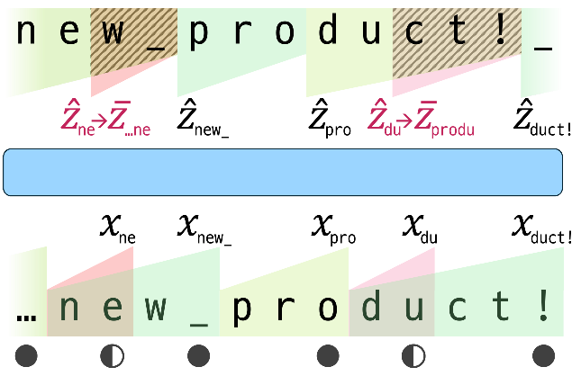
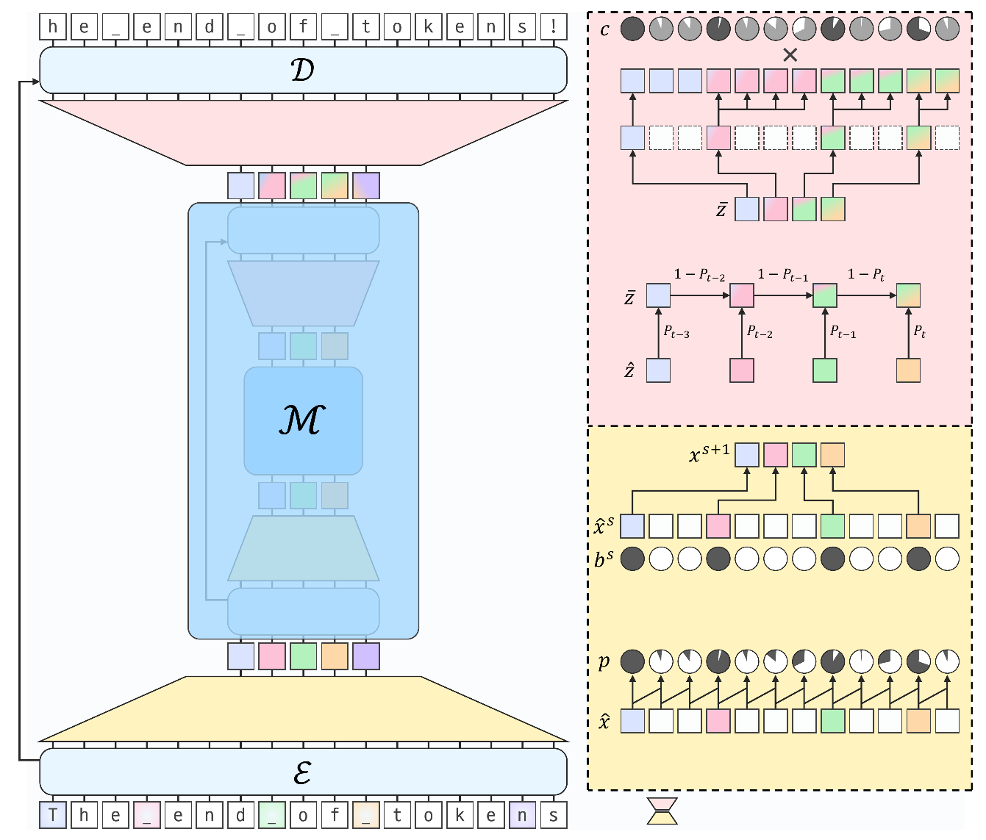
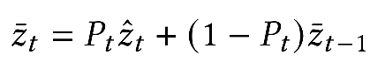
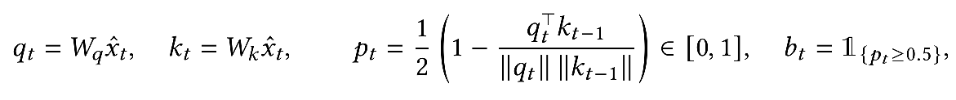
H-Net
Smoothing:
No pooling (discards tokens)
Images from: S. Hwang, B. Wang, A. Gu, Dynamic Chunking for End-to-End Hierarchical Sequence Modeling, 2025.

Slide 13
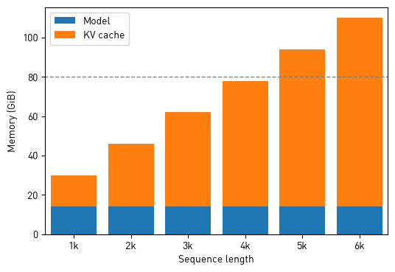
Shifting Attention to KV Cache
“Software 3.0” built on top of LLMs
(Andrej Karpathy)
Optimizing inference instead of training
Apps
Derivative Models
Foundation Models
For long contexts:
N× KV cache compression
N× speed up
Llama 2 7B, BS=32 (A100 80GB, BF16)

Slide 14
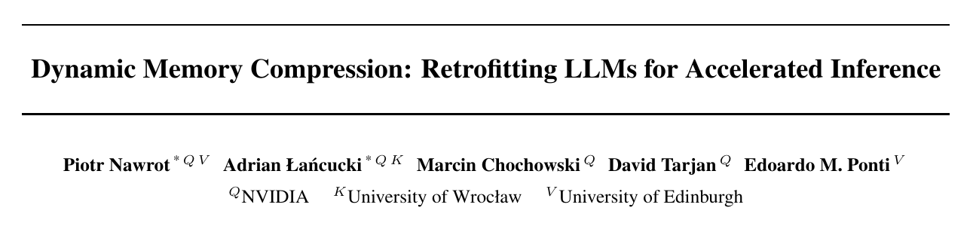

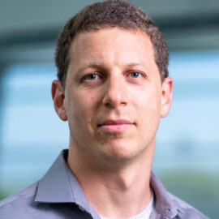
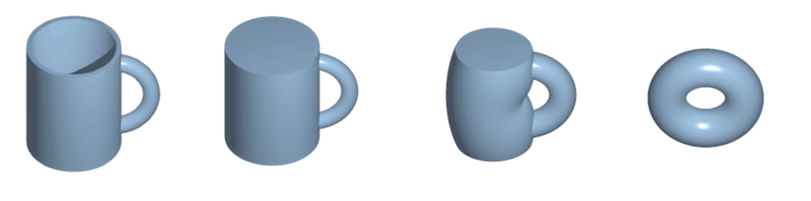
Dynamic Memory Compression (ICML 2024)
Piotr Nawrot
Marcin Chochowski
End-to-end dynamic pooling for KV cache
Slowly adapt an existing model to pool tokens making discrete decisions
David Tarjan
Edoardo M. Ponti
FM
Compressing FM

Slide 15
DMC Framework
Pool K and V sequences of each head at every layer
The compression of V mirrors the compression of K
Input/output resolution remains unchanged
No need to upsample!
MatMul
Softmax
MatMul
Pooling
Q
K
V

Slide 16
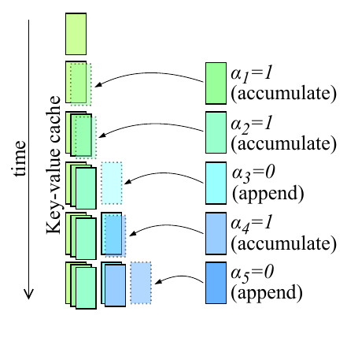
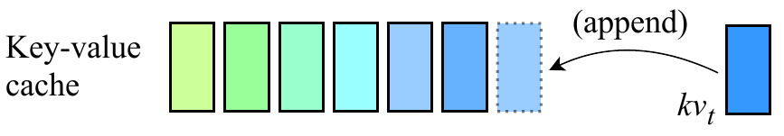
DMC Inference
Vanilla transformer inference
Append the next token to the KV cache
DMC inference
The models decides to append or accumulate (pool)

Slide 17
DMC Training
α=0
α=0
α=0
α=0
α=0
α=.5
α=.8
α=0
α=.2
α=1
α=1
α=1
α=0
α=1
α=1
No pooling
Pooling with discrete boundaries

Slide 18
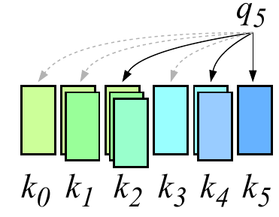
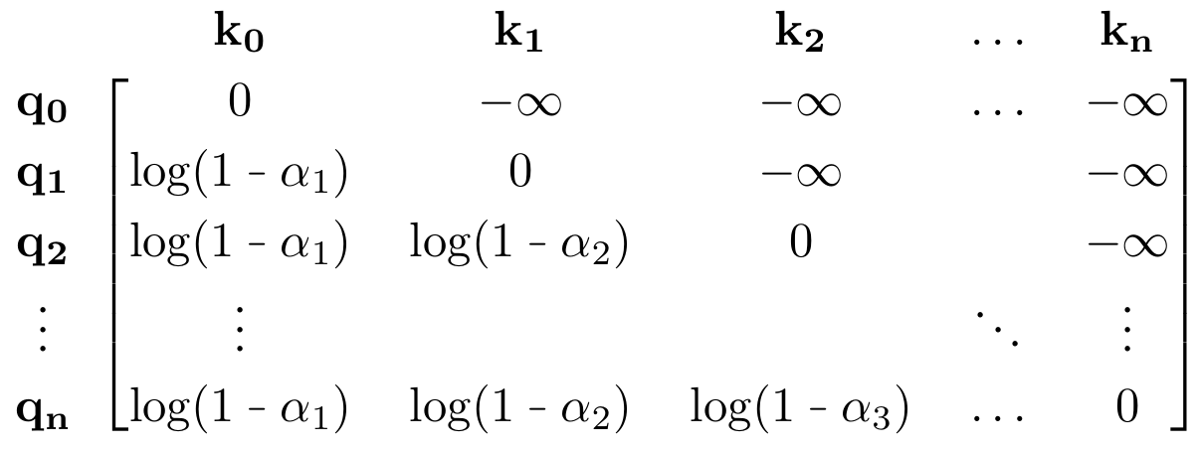
DMC Training
All intermediate tokens are retained during training
Partial tokens should not be accessible
α determine, whether states are partial or final
We apply partial masking which relies on α
MatMul
Softmax
Pooling-aware Mask
MatMul
Pooling
Q
K
V

Slide 19
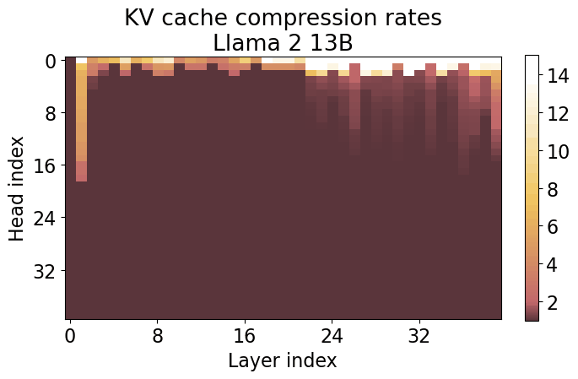
Every Head Learns a Custom Compression
Compression rate heatmaps

Slide 20
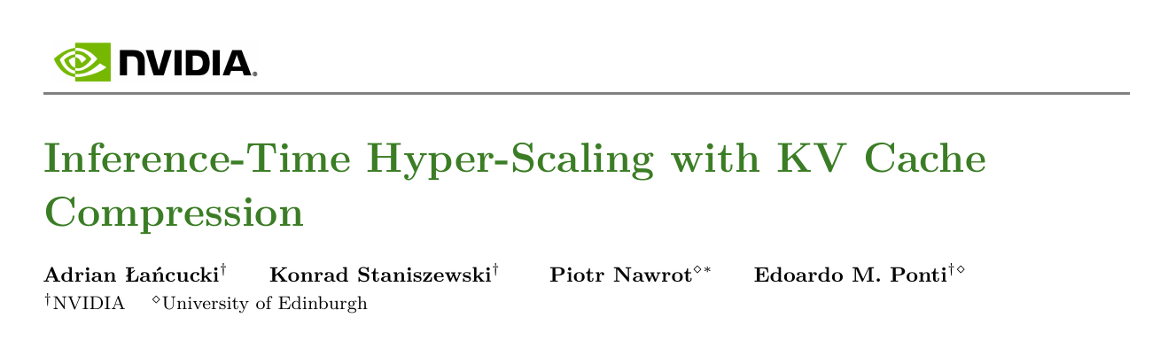
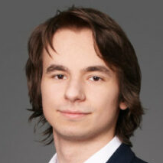
Dynamic Memory Sparsification (2025)
Konrad Staniszewski
Piotr Nawrot
Goals
Simplify DMC to speed up training
Draw from KV cache compression research
Token eviction and sliding windows
Edoardo M. Ponti

Slide 21
Dynamic Memory Sparsification (DMS)
Simplification of the DMC algorithm
Train a model to perform token eviction instead of merging
MatMul
Softmax
Pooling-aware Mask
MatMul
Pooling
Q
K
V

Slide 22
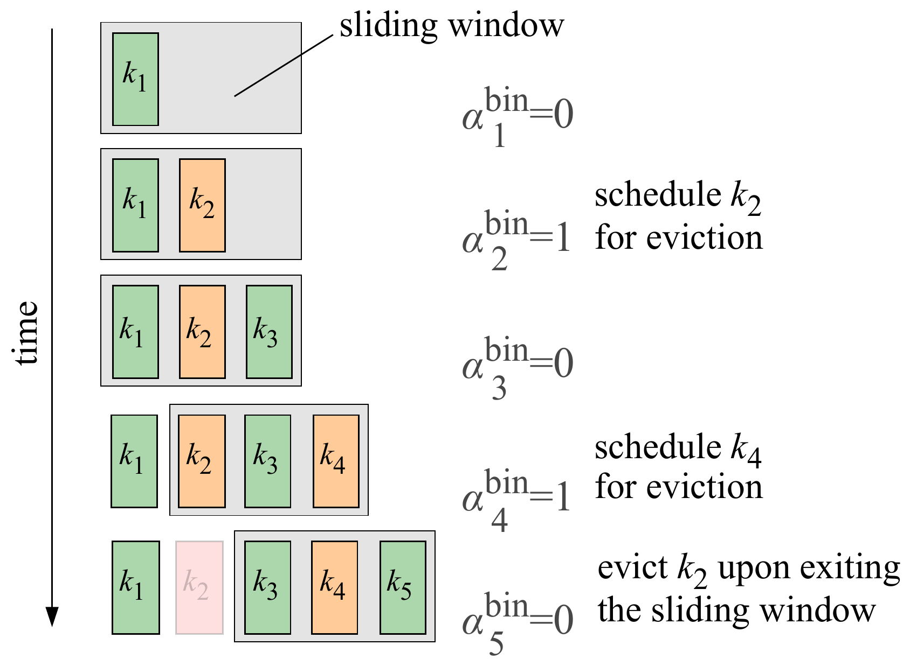
Dynamic Memory Sparsification (DMS)
Delayed eviction after decision
Let the model extract information from tokens marked for eviction
Creates a sliding window
Deciding about eviction of k₂ with α₅ worsens accuracy
k₂ = W_{k} x₂
α₂ = w_{α}^{T} x₂
Notes:
alpha5 for k2 would require learning to attend to (current_pos - window_size)
Inexpensive training; the information of token usefulness is there from day 1. No need to track it’s attn scores during token’s lifetime.

Slide 23
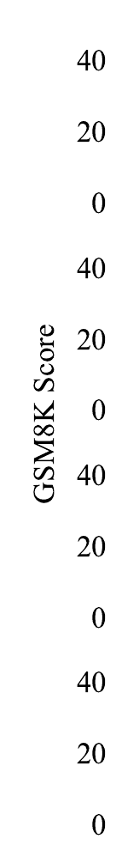
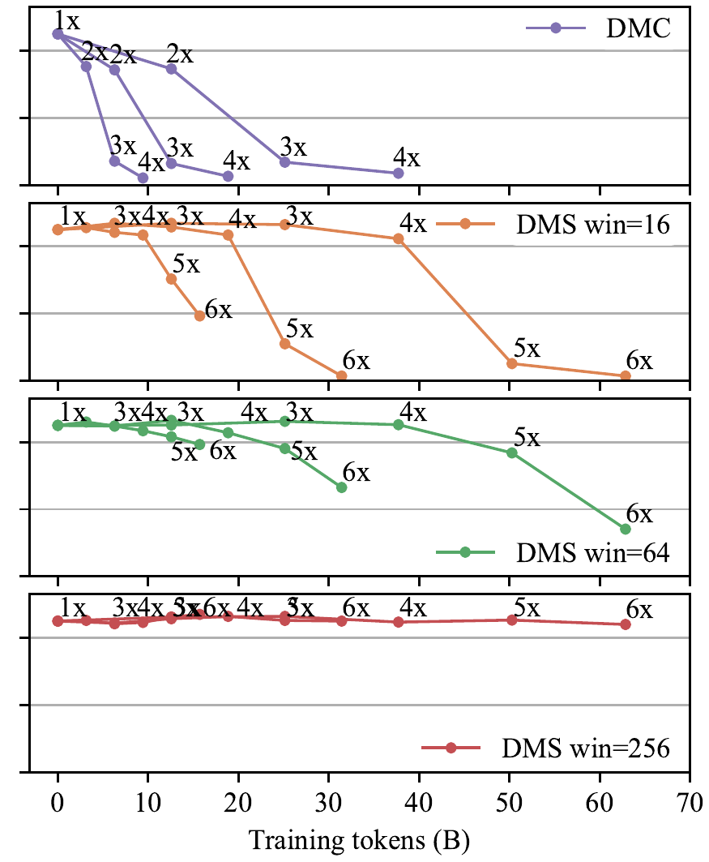
Sliding Window Sizes and Data Efficiency
Llama 3.2 1B Instruct
Even with extreme data efficiency (700 steps) we can achieve 8x compression
Larger window sizes are more robust (win=256 adopted in experiments)
DMS is more robust than DMC degrades easily in fragile small models

Slide 24
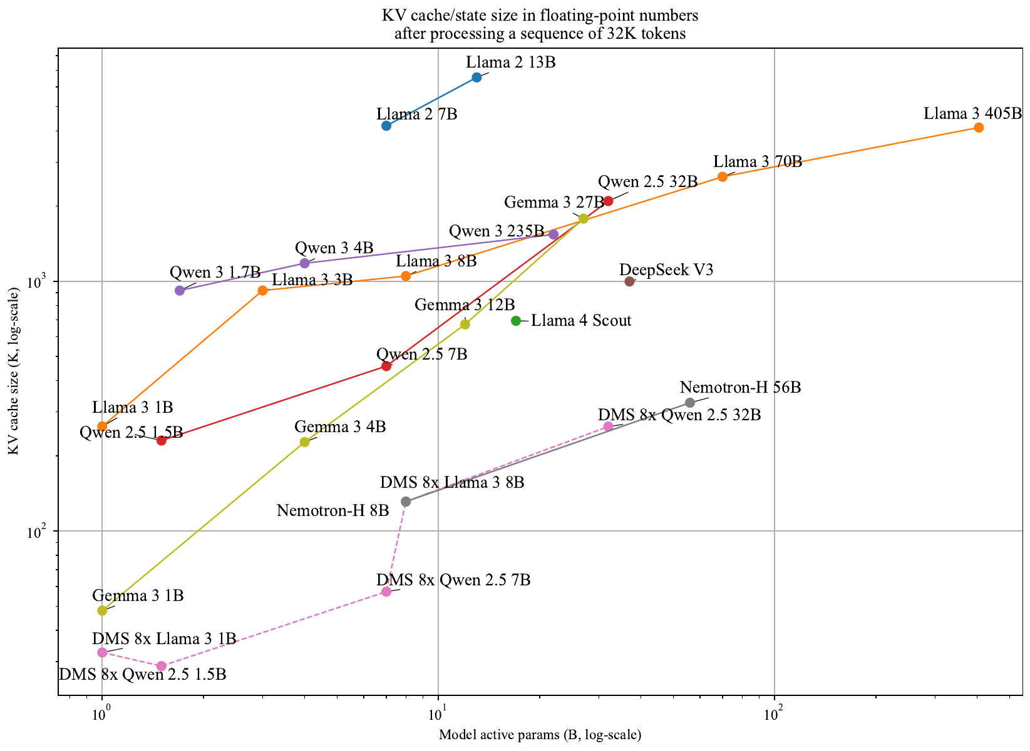
Gemma 3 and Llama 4 mix sliding-window and global attention layers
Nemotron-H mixes Mamba-2 and global attention layers
DeepSeek V3 has Multi-head Latent Attention (MLA)
Notes:
Gemma 3 and Llama 4 mix sliding-window and global attention layers
Nemotron-H mixes Mamba-2 and global attention layers
DeepSeek V3 has MLA

Slide 25
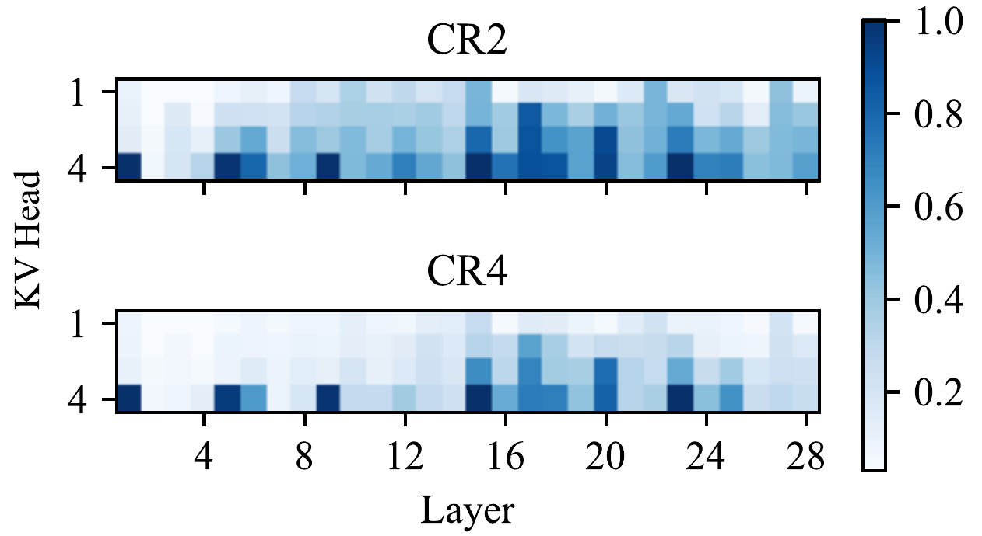
Recent Trends - Local:Full Attention
Gemma 3 (March 2025) | 5:1 ratio of local (win=1k) to full attention
Llama 4 (April 2025) | 3:1 ratio of local (win=4k) to full attention
Nemotron-H (May 2025) | ~11:1 ratio of Mamba-2 to full attention
Local:full attention patterns are currently designed by hand. DMS learns similar patterns automatically.
Local (win=256)
Full attention

Slide 26
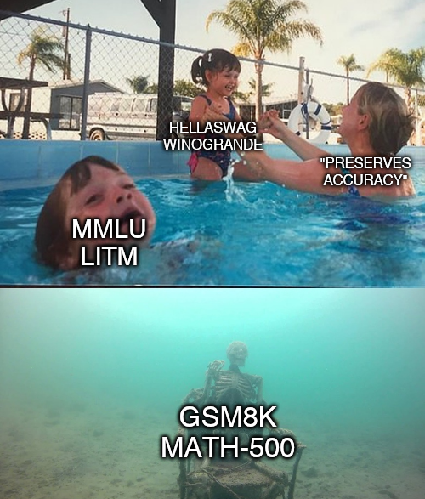

Slide 27
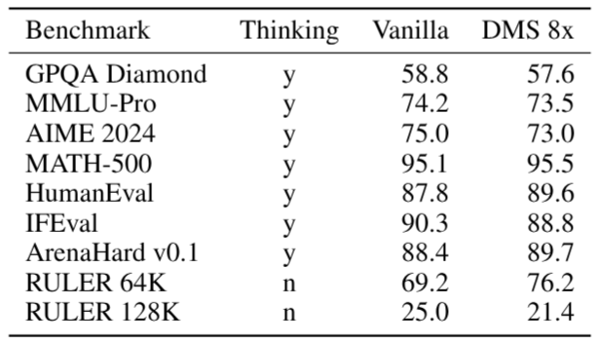
Qwen3-8B DMS 8x

Slide 28
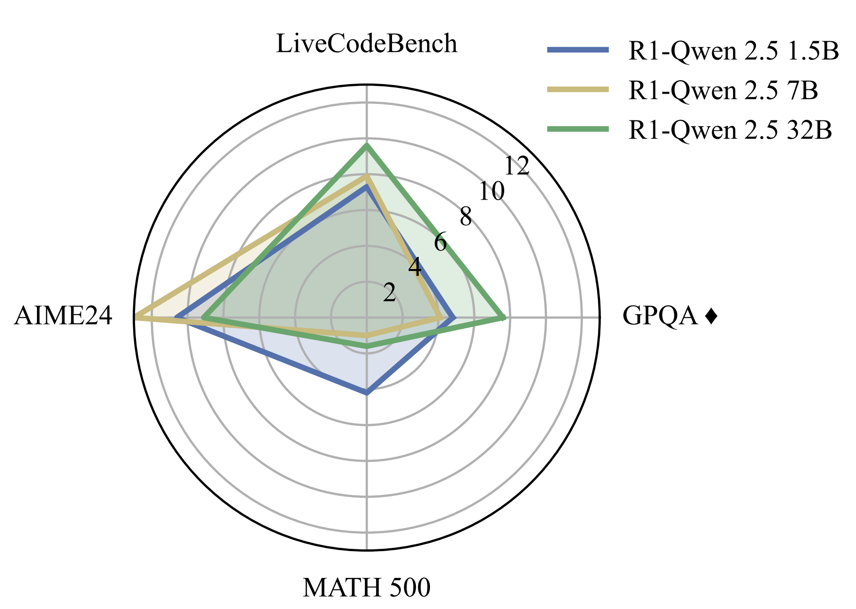
Average Gains in Inference Scailing
DMS vs Vanilla under fixed token budgets

Slide 29
Conclusions
Three approaches for learning end-to-end compression/eviction in Transformer models:
DPT: dynamic hourglass architecture by pooling hidden states
DMC: faster inference autoregressive pooling of KV cache
DMS: inexpensive eviction of KV tokens
Hope to see more adoption in the future!

Slide 30
Learning Dynamic Segmentation and Compression
of Sequences in Transformer LLMs
Adrian Łańcucki
alancucki@nvidia.com
October 16th, 2025

Slide 31
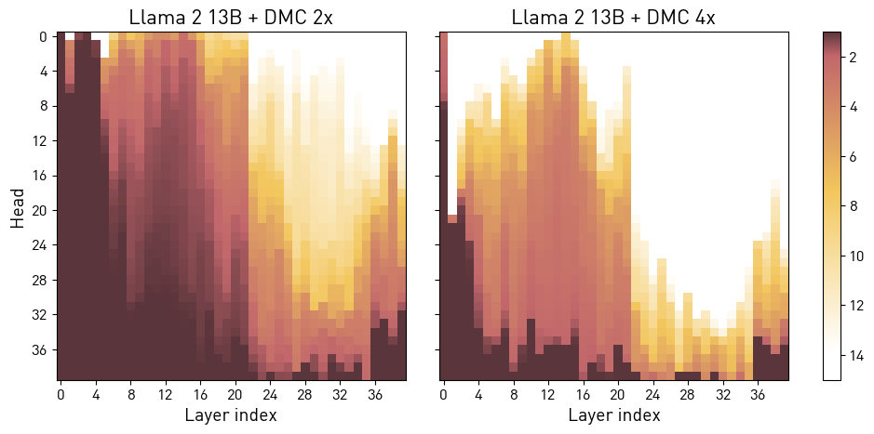
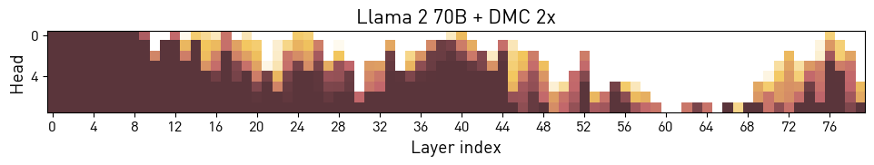
Every Head Learns a Custom Compression
Compression rate heatmaps

Slide 32

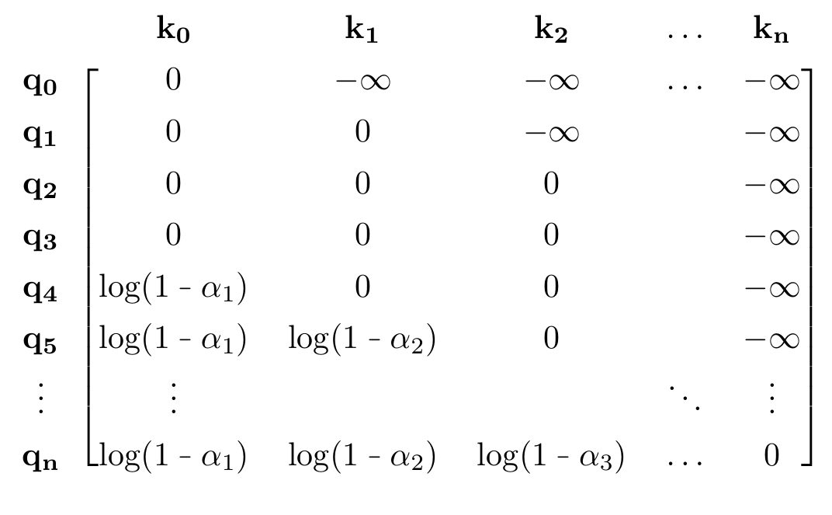
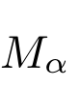
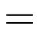
DMS Training
Inference
Training
Query
Key
Eviction decisions α_{t} determine an additive mask
They are continuously relaxed from {0, 1} to [0, 1]
Eviction
Sliding window

Slide 33
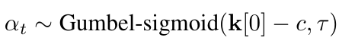
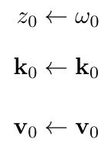
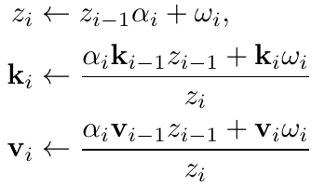

Recurrent Pooling
Average pooling rewritten as a recurrence:
Relaxing alpha yields partial averaging (smoothing)
This can be re-written as associative and calculated efficiently with parallel scan [1].
α=0
α=0
α=0
α=0
α=0
α=.5
α=.8
α=0
α=.2
α=1
α=1
α=1
α=0
α=1
α=1
No pooling
Pooling with discrete boundaries
[1] G.E. Blelloch, Prefix Sums and Their Applications, in: Synthesis of Parallel Algorithms, 1990
Notes:
GPU-friendly if-else
Gumbel sigmoid with low temperature, start with probability 0

